Slide 1

V450: Project Management & Implementation
Class 9
Scope of Work III: Scope Action Plan
“Unless commitment is made, there are only promises and hopes; but no plans.” – Peter F. Drucker."

Slide 2
Warm-Up
How do you stay motivated during challenging courses? What resources do you use?
How has your approach to learning changed since starting college?

Slide 3
ꚙ “Oh, hey, wait a minute…” ꚙ
Today’s
PM Problem

Slide 4
The city of Oakwood decided to upgrade its public transportation with a new "Smart Transit System" that included real-time bus tracking and digital payment options. A major software company, TechSolutions, was hired to develop the system.
The project charter was signed, and TechSolutions began work based on this project scope statement: “Develop and implement a user-friendly Smart Transit System for the City of Oakwood."
You, the now-experienced PM, decide to look down the tracks toward the end of the project, and look for snags, miscommunications and other endangerments to your beloved Iron Triangle.

Slide 5

Write down 3 possible snags, and how you’d fix them.

Slide 6

The lack of detail led to a series of miscommunications and assumptions, which led to scope creep.
User Types: Was the system for city residents only, or would it also serve tourists and commuters from neighboring towns?
Payment Methods: What specific payment types would be accepted? (e.g., credit cards, mobile wallets, a new proprietary transit card).
System Integration: Would the system need to integrate with existing infrastructure, like bus cameras or old ticketing machines
Maintenance and Support: Who was responsible for ongoing system maintenance after launch?

Slide 7

What are the two main reasons PMs say projects fail?
Scope creep and lack of understanding of the clients' vision.
___ are a critical measure of a project’s success.
Expectations

Slide 8
Today’s Objectives
Understand that a project scope action plan is the natural extension of the project scope statement.
Practice pulling in all team members when creating an action plan, DO NOT go Lone Wolf.
Remember the action plan is vital because it keeps the whole team focused on their common goals and objectives.

Slide 9

Big 5 Pre-Questions/Pre-Planning
↓
Requirements
↓
Expectations
↓
Goals & Objectives
↓
Deliverables
↓
Scope of Work Statement & Action Plan
↓
Work Breakdown Structure
The Big Plan
Notes:
Here is the flow of works when preparing the scope for a project.

Slide 10
As we look deeper into the scope of work, let’s repeat our warning about scope creep - uncontrolled growth in what work needs to be done.
It almost always results in delays, cost overruns or diminished quality.
It is also one of the biggest reasons projects fail.
Notes:
Read.

Slide 11
Scope is one of the primary areas of project distress. A big cause is scope creep - uncontrolled growth in what work needs to be done.
Project sponsors and executives assume the scope broadly includes everything that is reasonable to produce the deliverables, but project managers want to account for every resource.
Notes:
And it’s worth repeating that I virtually guarantee not everyone has the same expectations for a project when it starts. NOW is the time to sort those differences.

Slide 12
When the parties do not want to confront the issues regarding the project boundaries at the outset, it is a formula for problems.
Notes:
And it’s worth repeating that I virtually guarantee not everyone has the same expectations for a project when it starts. NOW is the time to sort those differences.

Slide 13
Why Projects Go Wrong
Inadequately trained and /or inexperienced project managers.
Failure to set and manage expectations.
Poor leadership at any and all levels.
Failure to adequately identify , document and track requirements.
Poor plans and planning processes.
Poor effort estimation.
Misalignment between the project team and the business or other organizations it serves.
Inadequate or misused methods.
Inadequate communication, including progress tracking and reporting loop.
Notes:
A project scope statement is vital if you’re going to avoid common mistakes like:

Slide 14

What about human nature makes us avoid thinking about risks?

Slide 15
Humans often avoid thinking about risks due to a combination of cognitive biases, emotional responses and the tendency to seek information that confirms preexisting beliefs.
These factors can distort our perception of risk, leading to a more conservative approach. Understanding these influences can help individuals make more informed decisions and navigate the complexities of risk with greater clarity and effectiveness.

Slide 16

You’ve been assigned to build a birdhouse. How would you get ready?
Break the project down into stages, and list an item or two under each stage.

Slide 17
You’ve been assigned to build a birdhouse. How would you get ready?
Break the project down into stages, and list an item or two under each stage.

Slide 18
You did a great job on the birdhouse, so now you’ve been assigned to merge two divisions at work - IT and HR
Break the project down into stages.

Slide 19

Scope of Work

Slide 20
Expectations must be managed
from the start.
Expectations are managed
in the scope of work..
Notes:
Read.

Slide 21

Project Scope Statements

Slide 22
Within PMBOK), the project scope statement defines what a project will deliver.
The project scope action plan defines how the project's scope will be managed.
Notes:
And it’s worth repeating that I virtually guarantee not everyone has the same expectations for a project when it starts. NOW is the time to sort those differences.

Slide 23
The project scope statement is a description of the project's deliverables and the work required to create them.
Think of it as a blueprint for the project's final product or service. Its main purpose is to provide a clear and common understanding of the scope among all stakeholders.
Notes:
And it’s worth repeating that I virtually guarantee not everyone has the same expectations for a project when it starts. NOW is the time to sort those differences.

Slide 24
A project scope statement is the sum of all work that needs to be done. It helps project managers define the boundaries of what will and what won’t be done.
Your project scope statement will act as the primary tool for stakeholders and teammates to reference and use as a guideline to accurately measure project success.
Notes:
A project scope statement is the sum of all work that needs to be done and will be your trusty road map throughout the prject..

Slide 25
To write a project scope statement, you’ll need to understand the project goals, requirements and expectations among other things.
Notes:
To write a project scope statement, you’ll need to understand the project goals, work breakdown structure and requirements, among other things.

Slide 26
PMBOK identifies four tools and techniques to writing a scope statement:
Expert Judgment. It is indeed a huge advantage to have resident experts to consult when defining a project scope. Subject matter experts can identify the expected pitfalls and potential issues that can be defined at the project planning stage, and their input is invaluable.
Product Analysis. Focus on the deliverables. What do they look like? How long/high/wide/strong/capable must they be? What functions will they have, and how must they perform under various conditions?
Alternatives Generation. Determining alternative products and services can be extremely eye opening. This can identify different approaches to performing the work, which can be instrumental in defining the scope.
Facilitated Workshops. When you have many grey project boundaries (or worse, conflicting ones), consulting the project stakeholders and putting them together in one room or conference call can be essential to defining the project scope.
Notes:
When you’re new to writing scope statements, GET HELP! Ask around. Find examples. R&D.

Slide 27

Key project scope statement components include:
Product Scope Description: The features and functions of the final product, service or result.
Scope of Work: A high-level description of what is in and what is out of the boundaries of the work.
Deliverables: A list of all results the project will produce.
Project Exclusions: Explicitly stating what is not included in the project to prevent scope creep.
Constraints and Assumptions: Any limitations (like budget or time) or factors believed to be true that could affect the project.
Notes:
And it’s worth repeating that I virtually guarantee not everyone has the same expectations for a project when it starts. NOW is the time to sort those differences.

Slide 28
Constraints: All projects work within constraints, and stakeholders might not be aware of them.
For example, a renovation project that will release fumes which might concern the neighbors might plan for a fan and piping system to send the fumes a sufficient distance away.
It might be easy to say in the scope statement that the fan will send the fumes away, but if it goes a bit further and describes the constraints, i.e. how far the residences are away, how many windows there are, and how easily the fumes might travel, the stakeholders who read the scope statement might understand if it ever becomes difficult to contain the fumes.
Notes:
A special word about constraints, because all projects have them. All projects work within constraints, and stakeholders might not be aware of them. By listing the constraints explicitly, the stakeholders can understand what has been assumed and this can result in a listening ear when problems arise.

Slide 29
Assumptions: Similar to constraints, the assumptions provide background information that will allow for stakeholders to understand when problems arise.
Assumptions often fly under the radar, particularly for inexperienced professionals.
In our renovation project example, the project manager will have to assume a certain size fan. If the fumes begin to leak out of the building and get to the neighboring properties, problems could result. Stating the assumption that a certain fan size will be sufficient would reduce project risk.
Notes:
Being clear about constraints can help clear up faulty assumptions.

Slide 30
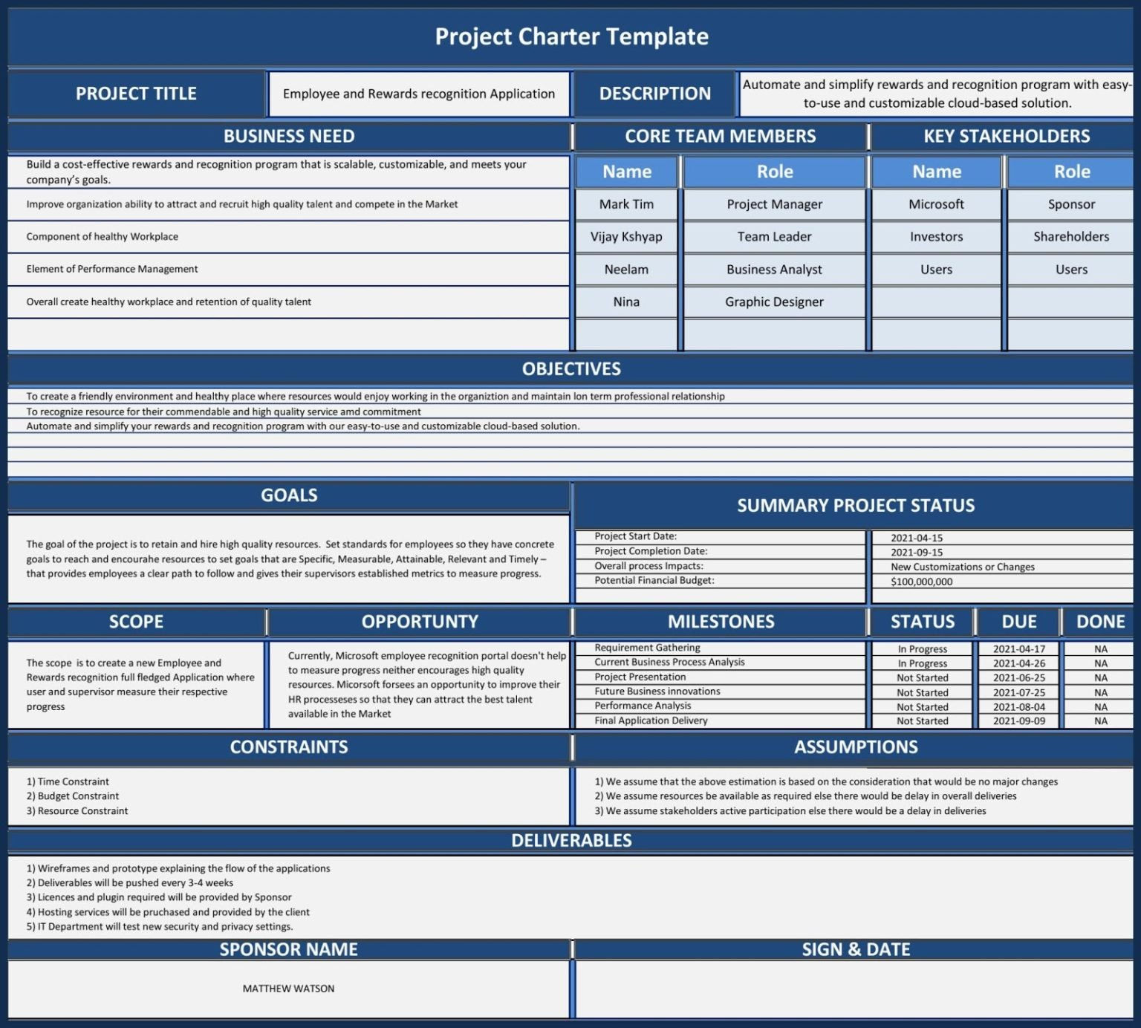
Notes:
Note the appearance of key words like Goals, Scope of Work and Contstraints.

Slide 31
Notes:
Note how it includes things like Assumptions about how the project will go, and Deliverables for the client.

Slide 32
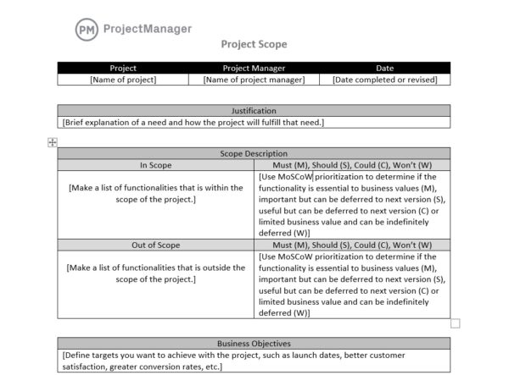
Notes:
Here’s an example of a scope statement.

Slide 33
Notes:
Note that it includes a list of what you’re going to do – AND – to avoid unspoken expectations, it also lists what you’re NOT going to do.

Slide 34
Start with a General Project Statement
A project statement provides a short narrative on the nature of the project, why it is necessary and how the team intents to go about it.
The statement informs the creation of the scope of work, which in turn governs all other actions. It also clarifies for the clients and participants why the plan is being conducted, and avoids wrong assumptions.
Notes:
A project statement provides a short narrative on the nature of the project, why it is necessary and how the team intents to go about it.

Slide 35
The length of the scope statement has no strict guideline. It should be long enough to limit the risk of scope change as much as possible, to a reasonable limit.
Although you can’t define the scope perfectly, when all stakeholders should have a good idea of the project’s boundaries the scope statement is detailed enough.
Notes:
Read.

Slide 36
Example of a scope statement
Design a bridge that meets all state road design standards while providing adequate stream flow for a 1:100-year flood event.
Erosion of the bridge abutments must be reasonably controlled, and environmental permits must be obtained and strictly adhered to.
Notes:
Read.

Slide 37
Project Statement
Use their process, substituting the word “problem” for “project.”
[1] Trigger: What problem triggered the project? Why is action needed – to prevent something, to create a needed solution?
[2] Action: What action needs to be taken?
[3] Frequency & Timing: When and how often will the decision be made? Are other decisions linked to this one?
[4] Scope: How large, broad, complicated is the project?
[5] Constraints & Uncertainty: Legal, financial, political, ‘minimum performance’. Perceived or real constraints? Be creative.
Notes:
Read.

Slide 38
Example: Project Statement
Trigger: Due to the lack of business exposure and marketing, there is a scarcity of customers for local businesses in Owen County.
Action: To fix this issue we will create a partnership between the American Marketing Association at IU a marketing organization that we build a partnership with Indiana University Center for Rural Engagement and American Marketing Association with local businesses in Owen County that do not have websites. The Owen County Chamber of Commerce will be the middle-man to and will use this partnership as a resource tool.
Frequency: As a capacity-building project, this project and its implementation will be on-going in Owen County. It is expected that the partnership will grow throughout the county at different rates, depending on the willingness of each business to accept help and the efficiency of the marketing organization we chose to partner with. The community will have to continue to hold conversations and revise plans over time in order to ensure accountability in the project.
Scope: This project will involve Owen County as a whole with a focus on business owners, the Chamber of Commerce, and a partnership with an outside organization (like the AMA).
Constraints: The constraints include the lack of budget, the willingness of local businesses to accept help, the efficiency/effectiveness of the marketing organization that we build a partnership with, and limited resources that we as a group have available to us.
Uncertainty: In light of developing and expanding current businesses, we are uncertain if COVID restrictions will hinder our business exposure partnership or if business owners will be open to changes.
Notes:
Read.

Slide 39
Don’t let perfect be the enemy of good.
Attempting to define the perfect set of requirements stalls a project. if the requirement doesn’t relate to an objective, bin it.
Ask yourself, “Am I trying to create something perfect here, when good will do?” If you are, review the requirements again filtering for good rather than perfect.
Notes:
Having said all this, eventually the scope must be completed. Don’t be afraid to finalize it. Fortunately, you’ll get better at it as you go.

Slide 40
Scope Action Plan

Slide 41
As discussed, a project scope statement is a summary of all work that needs to be executed. It helps project managers define the boundaries of what will and what won’t be done.
The next logical step is a project scope action plan, which makes clear to the planning team, all the steps that will be performed to complete the scope.
Notes:
Don’t read.

Slide 42
It is not an overstatement to say that a plan with well-defined and clearly agreed scope action plan is already halfway to success: the clearer you are about what you will be doing, the more likely you are to achieve them.
Notes:
No kidding – get the scope of work right and you’re half-way home.

Slide 43
Do not kick this can down the road.
Address possible problems now.
Notes:
Read.

Slide 44
The scope action plan is where you think through all the activities promised in the scope statement.
Begins each statement with an action (undertake, produce, commission, identify).
Notes:
As you start deciding specific things to do – meetings, interviews, research – begin each statement with an action verb.

Slide 45
1. Undertake research to understand the number of homes in the area (and therefore the number of recycling bins required).
2. Produce a design for the recycling bins to be provided to the manufacturer.
3. Commission a supplier to manufacture the agreed number of recycling bins in accordance with the design which will be provided as an output of (2.).
4. Identify and implement a means of distribution that will ensure that all homes receive their allocation.
Notes:
Notes these highlighted examples.

Slide 46

Why is it vital that PMs don’t create the scope action plans alone?
Notes:
Take a minute to answer this question.

Slide 47
PMs shouldn’t draft their Dream Plan in a silo, then try to sell it on teammates.
Begin with frank discussions about the team’s availability, commitment, necessary skills, etc.
Notes:
Read.

Slide 48
Every teammate working on the plan must have 100% agreement on what their exact duties and role will be.
Leave time to present the draft plan to each team member and get their feedback, revisions and finally buy-in. Don’t rush it.
Notes:
Read.

Slide 49
Going back to revise who’s-doing-what in the middle project is a sure-fire budget and timeline destroyer.
Notes:
Don’t read.

Slide 50
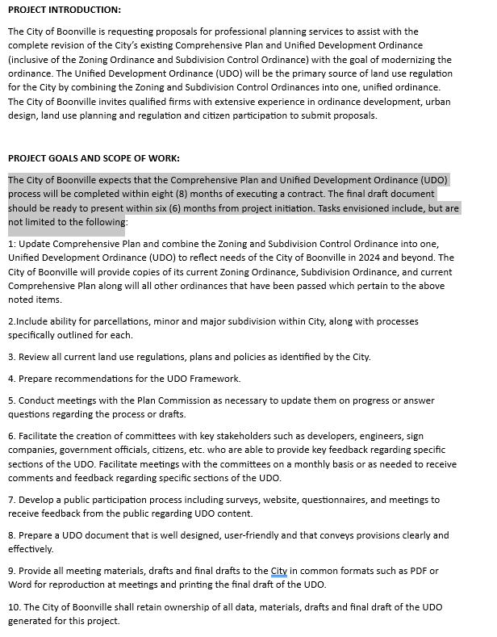
Example: Scope of work requested by a city for a comprehensive land use plan.
Notes:
Here’s an example of a city making clear their expectations and scope of work. They sent this Request for a Proposal to consultant firms, who are competing to win the work.

Slide 51
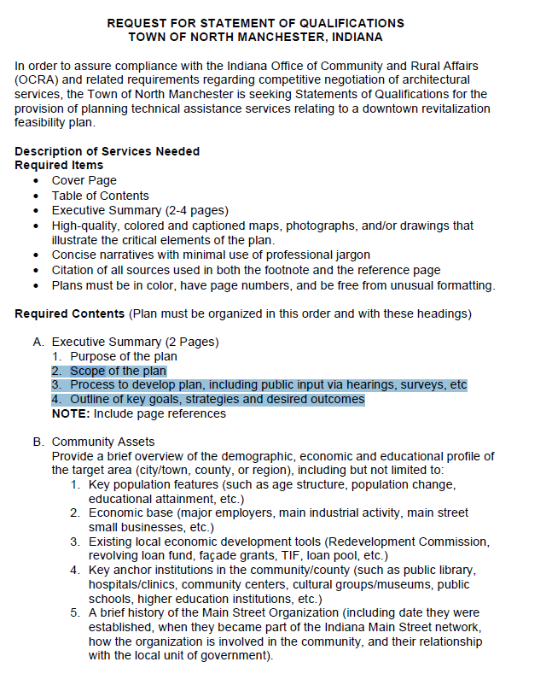
Example: Scope of work requested by a city for a downtown revitalization plan.
Notes:
Here’s another example where the city makes clear to the consult what the scope should include.

Slide 52

Example: Consultant team’s action plan response to a city for a downtown revitalization plan.
Notes:
Once consultants get these RFPs from cities, they research and create a fancy Response. Most of these are good-looking documents with lots of photos and explanations. Here’s an example of one I worked on.

Slide 53

Notes:
Here’s a closer look at the Scope of Work for the Proposal we prepared for a comp plan, where we explain all the public input we’ll perform, such as surveys and focus groups.

Slide 54
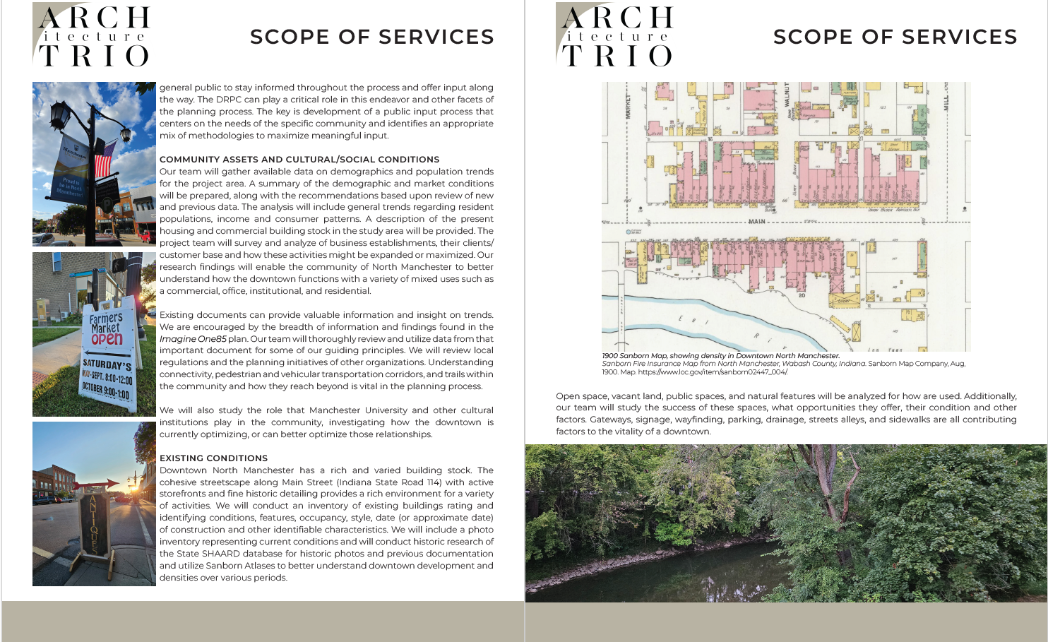
Notes:
Notice how detailed the scope is, explaining in detail what we’ll do at each step and why.

Slide 55
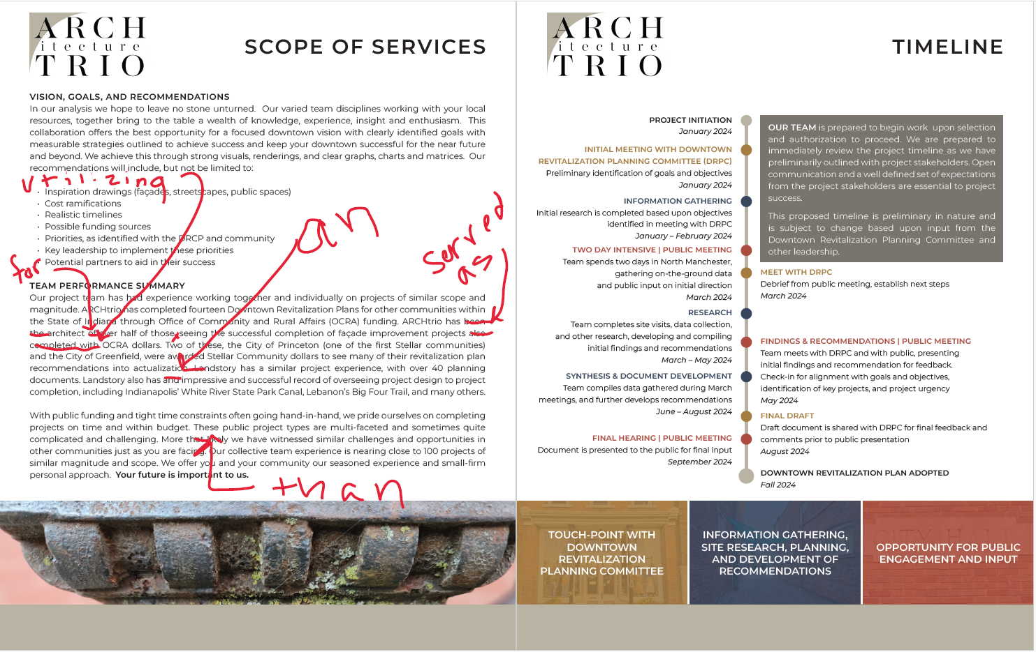
Notes:
Proposals also carry a timeline, in what order – and during what period – we will perform the scope of work.

Slide 56
Notes:
Here’s another example. Again, note the big category, such as Research and Data Collection, followed by specific tasks.

Slide 57
Comp Plan Scope of Work
Project Scope of Work
This scope of work provides for the full range of planning services to create a comprehensive land use plan and defines tasks necessary for its completion, including these broad steps:
Project initiation.
Citizen participation.
Evaluation of existing conditions.
Final plan.
Project initiation
Project initiation involves multiple tasks including the scheduling and refinement of project activities. The initiation phase will begin immediately following the issuance of a notice to proceed. Working with the town council, the consults will complete the following tasks:
Final edits on the scope of work, including likely dates for meetings, draft reviews and adoption.
Formation of the steering committee, which will provide support, guidance and oversight of progress. The consulting team will report to the local steering committee consisting of town council members and residents whom they appoint.
Collection of a list of key stakeholders, which includes people or organizations that are involved in the project or whose interests may be positively or negatively affected by the plan. These may include members of neighborhoods, the business community, school district and representatives of government agencies such as the Indiana Department of Transportation.
Conduct a site visit to refine the project team’s understanding of the existing conditions. This visit will be scheduled concurrent with the first steering committee.
Notes:
One last example.

Slide 58
If you hand a client a complete scope of work, you are giving them a project they can see.
If not, you’re giving them a wish list.
Notes:
Read.

Slide 59
What’s That? Too Much Damn Work?
You get faster with time and experience.
You create templates that can be tailored for later projects.
Maybe just pick one or two things that are especially important to you. If you’re not worried about the rest, then, well, don’t worry about them.
Become vitally important when someone else is doing the work.
Better defined your requirements are more likely to ensure the project as a whole delivers is exactly what is needed.
The effort you put into project definition up-front hugely reduces the risk of misunderstandings – or straight-up project failure – later. Poor requirements definition is one of the main causes of project failure.
Notes:
Read.

Slide 60
Snags, Defects & Missed Requirements
Snag. A minor mistake or oversight, but should be put right before the work is considered complete. It would be wrong to suggest that the project had failed on account of a snag, but you would still expect it to be put right.
Defects. At the next level we have issues which affect the underlying functionality or fitness-for-purpose of the finished product. It will be a failure to correctly deliver on one of the explicit or reasonably implied requirements. In other words, it is a mistake that can generally be corrected, but will require a little more effort and potentially some additional cost.
Missed requirements. These are straightforward – quite simply, a requirement that has been explicitly stated (or that should be reasonably implied) has been omitted from the final delivery - the sinking, gut-wrenching horror of discovering the overlooked email, buried deep in our inbox, that requested something we have not now done.
Notes:
Read.

Slide 61
Requirement Changes
If it was clearly defined in the agreed requirements, then it should have been delivered. If it has not been delivered, then it is incumbent upon the client to rectify that at their own cost.
If it was not clearly defined in the agreed requirements, there is no obligation on the PM to deliver it.
If the definition in the agreed requirements turns out to be unclear, or open to interpretation, then both parties will need to find a way to resolve the matter amicably (or possibly not, but this should always be the aim). This may mean reverting to mediation.
Notes:
Read.

Slide 62


Managing Expectations
Creating accurate project scope statements and action plans takes time, maybe weeks – and that time has to be allotted for in the schedule.
Bring in teammates and experts to help – which also takes time.
Watch for creeps and push through laziness (yours and others) in doing a thorough scope.

Slide 63
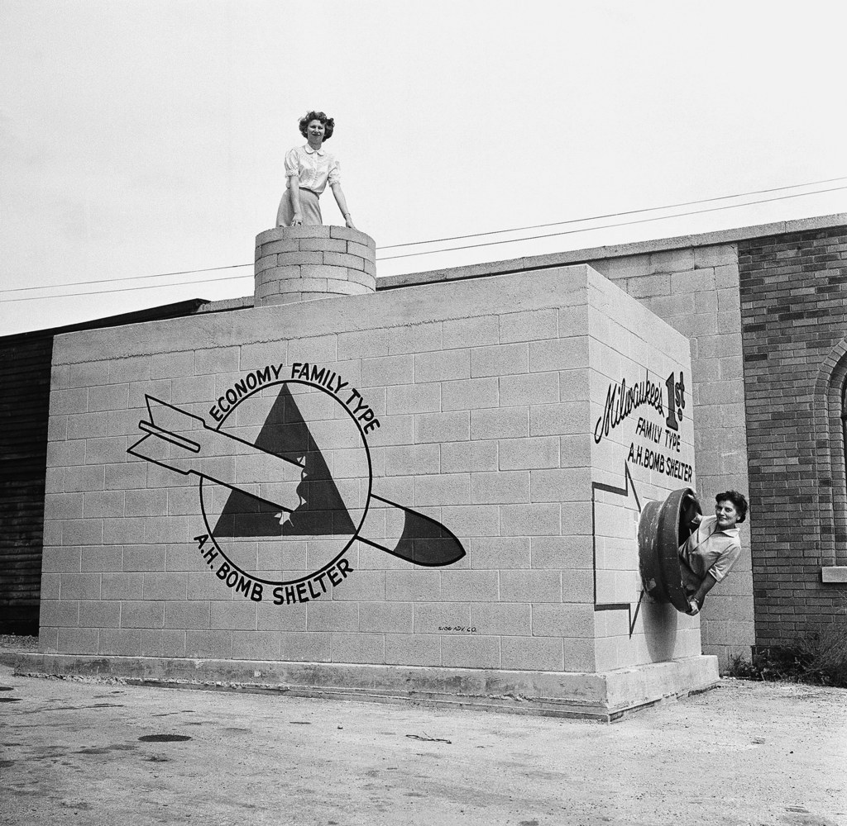

Slide 64
Class 10 Check-In

